Slide 1


Demat & Trading
Accounts
Setting up your digital infrastructure to start investing.

Slide 2


The Demat Account
De-Materialized means moving from physical paper to digital records. A Demat account is simply a digital locker for your assets.
Storage Only: You cannot use a Demat account to buy or sell. Its only job is to safely hold your assets.
Versatile: It doesn't just hold stocks. It holds Mutual Funds, Sovereign Gold Bonds, and ETFs.
Ultimate Security: The actual assets are kept safe with the central depositories (CDSL or NSDL), not the broker app on your phone.

Slide 3


The Trading Account
The Execution Engine
The Middleman
If the Demat account is the locker, the Trading account is the key and the vehicle. It is the actual interface (like the Zerodha or Groww app) you use to interact with the stock exchange.
A Trading account is provided by a Stock Broker. It acts as the crucial bridge connecting your Bank Account (where your cash is) to your Demat Account (where your shares will go).
When you click "BUY", the Trading account communicates with the exchange, pulls money from your bank, and sends the shares to your Demat.
Without a trading account, you cannot place an order on the NSE or BSE.

Slide 4








The Financial Trinity
1. Bank Account
3. Demat Account
2. Trading Account
This holds your raw Cash (Rupees). You transfer money from here into your Trading Account to prepare for a purchase.
The final destination. T+1 day after you buy, the digital shares are deposited here. When you sell, shares are pulled from here.
The operational layer. You use this software to select a stock, enter the quantity, and press the Buy or Sell button.

Slide 5

What is KYC?
KYC stands for Know Your Customer. It is a mandatory, non-negotiable process enforced by SEBI and the RBI.
Before any financial institution lets you open an account, they must verify your identity, your address, and your financial background.
Why? To prevent the stock market from being used for illegal activities, money laundering, funding terrorism, or massive tax evasion.

Slide 6

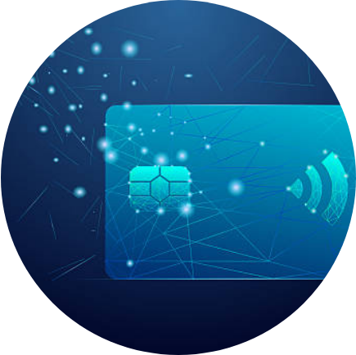
The Role of PAN
Permanent Account Number
In India, you absolutely cannot invest in the stock market without a PAN Card. It is your unique financial fingerprint.
Every single trade you execute, every dividend you receive, and every capital gain you make is permanently linked to this 10-digit alphanumeric code.
The Income Tax Department uses your PAN to track your market activity and ensure you are paying the correct taxes on your profits.

Slide 7

The Role of Aadhaar
Speed & Digital Verification
While PAN tracks your money, Aadhaar proves you are actually who you say you are, using biometric data.
12
The E-Sign Revolution: Previously, opening a Demat account took weeks of signing physical forms. Today, by linking your Aadhaar to your mobile number, you can digitally "e-Sign" documents using an OTP.
DIGIT UID
This allows your Trading and Demat accounts to be opened and activated in less than 24 hours.

Slide 8

Brokerage & Charges
Account Opening & AMC
Many discount brokers open accounts for free, but almost all charge an Annual Maintenance Charge (AMC) of around ₹300-₹500 per year just to keep your Demat active.
Brokerage Fees
The fee the broker charges for executing your trade. In discount brokers, Equity Delivery (long term) is usually free, but Intraday (buying/selling same day) costs roughly ₹20 per executed order.
Government Taxes (STT, GST)
You must pay a Securities Transaction Tax (STT) to the government on every trade, plus 18% GST on the brokerage charges, and small exchange turnover fees.

Slide 9
Great Job on Day 6!
Tomorrow: Stock Market Indices.
Don't forget to Like, Share, and Subscribe!
/ @EarnJoyOfficial

